Slide 1
OpenStreetMap for Slow Travellers

Slide 2
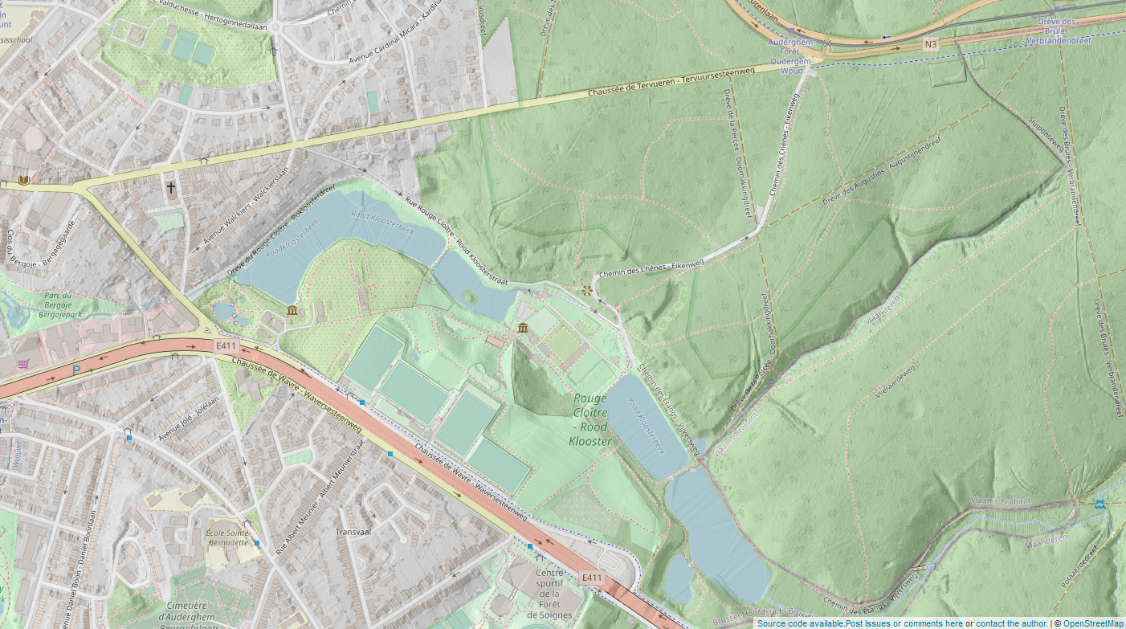
Notes:
When I first started talking about OpenStreetMap, often people had never heard about it
Now, things have changed
But a challenge remains: people are using OpenStreetMap and don’t realize it
https://play.osm.be/historischekaart.html#16/50.8926/4.0187/OSMorg-AIVHillshadesoftVL

Slide 3
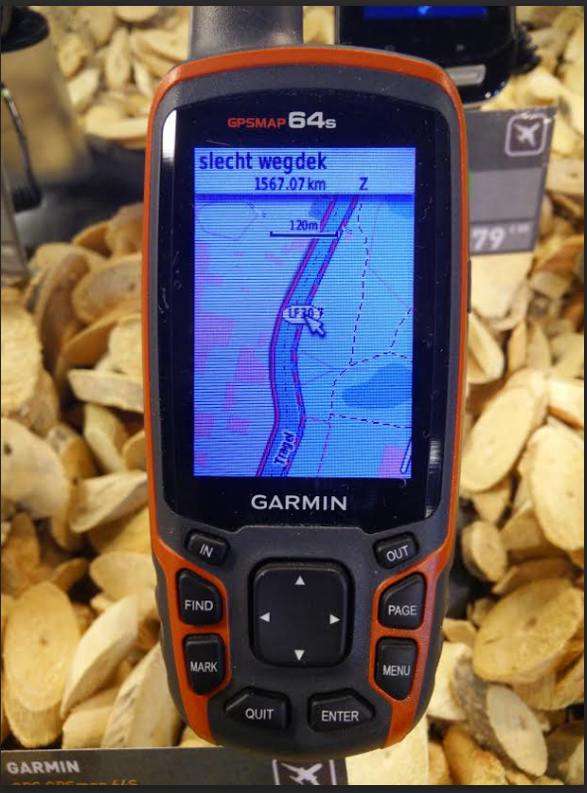
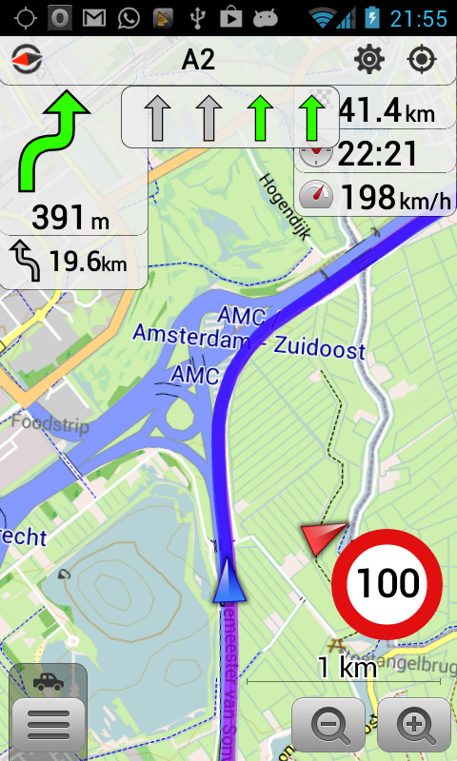
Notes:
But these days our data is everywhere

Slide 4
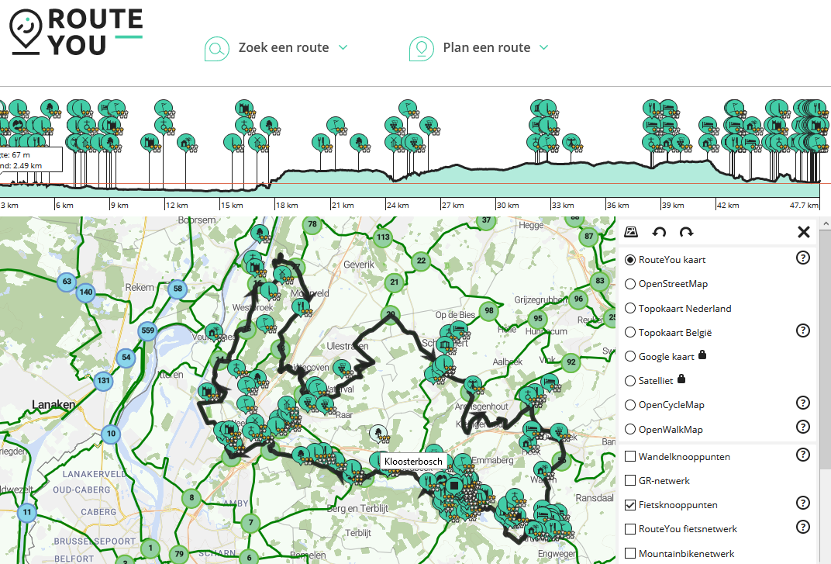
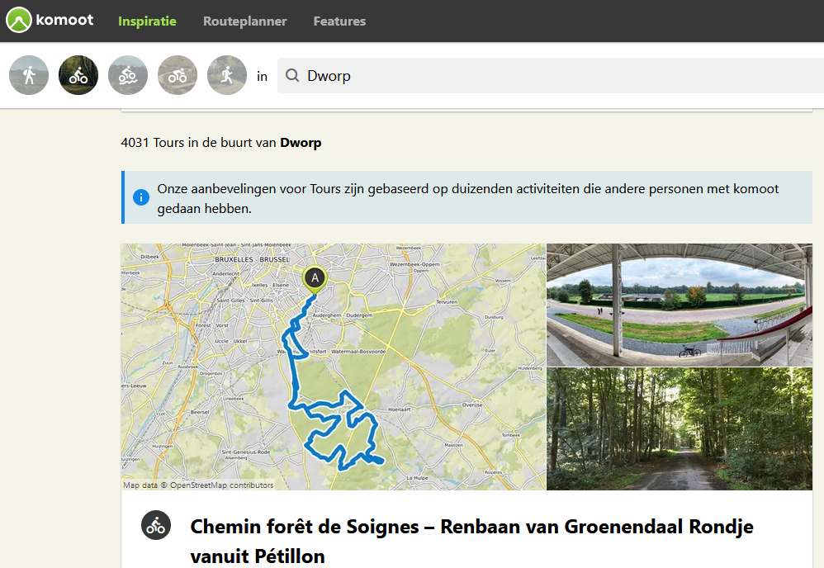
Notes:
It’s used by RouteYou and Komoot and similar
And also by default on all Facebook maps – behind Amazon delivery – used by anyone who plays pokemongo

Slide 5
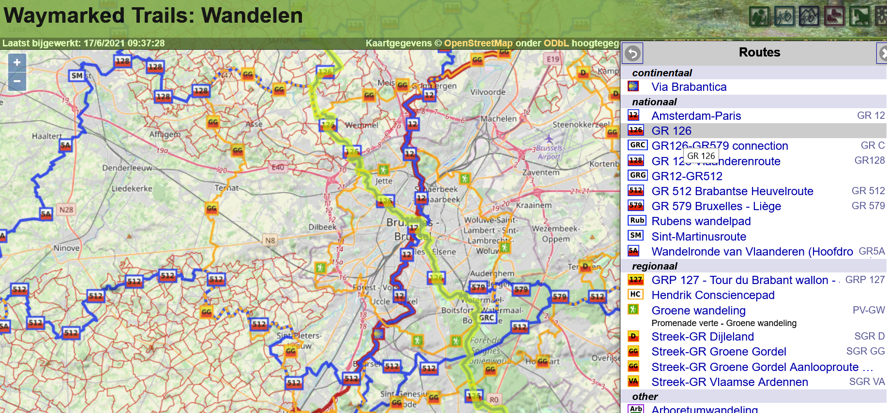
Notes:
And for example here, all the used data is just OSM data, nicely renderen

Slide 6
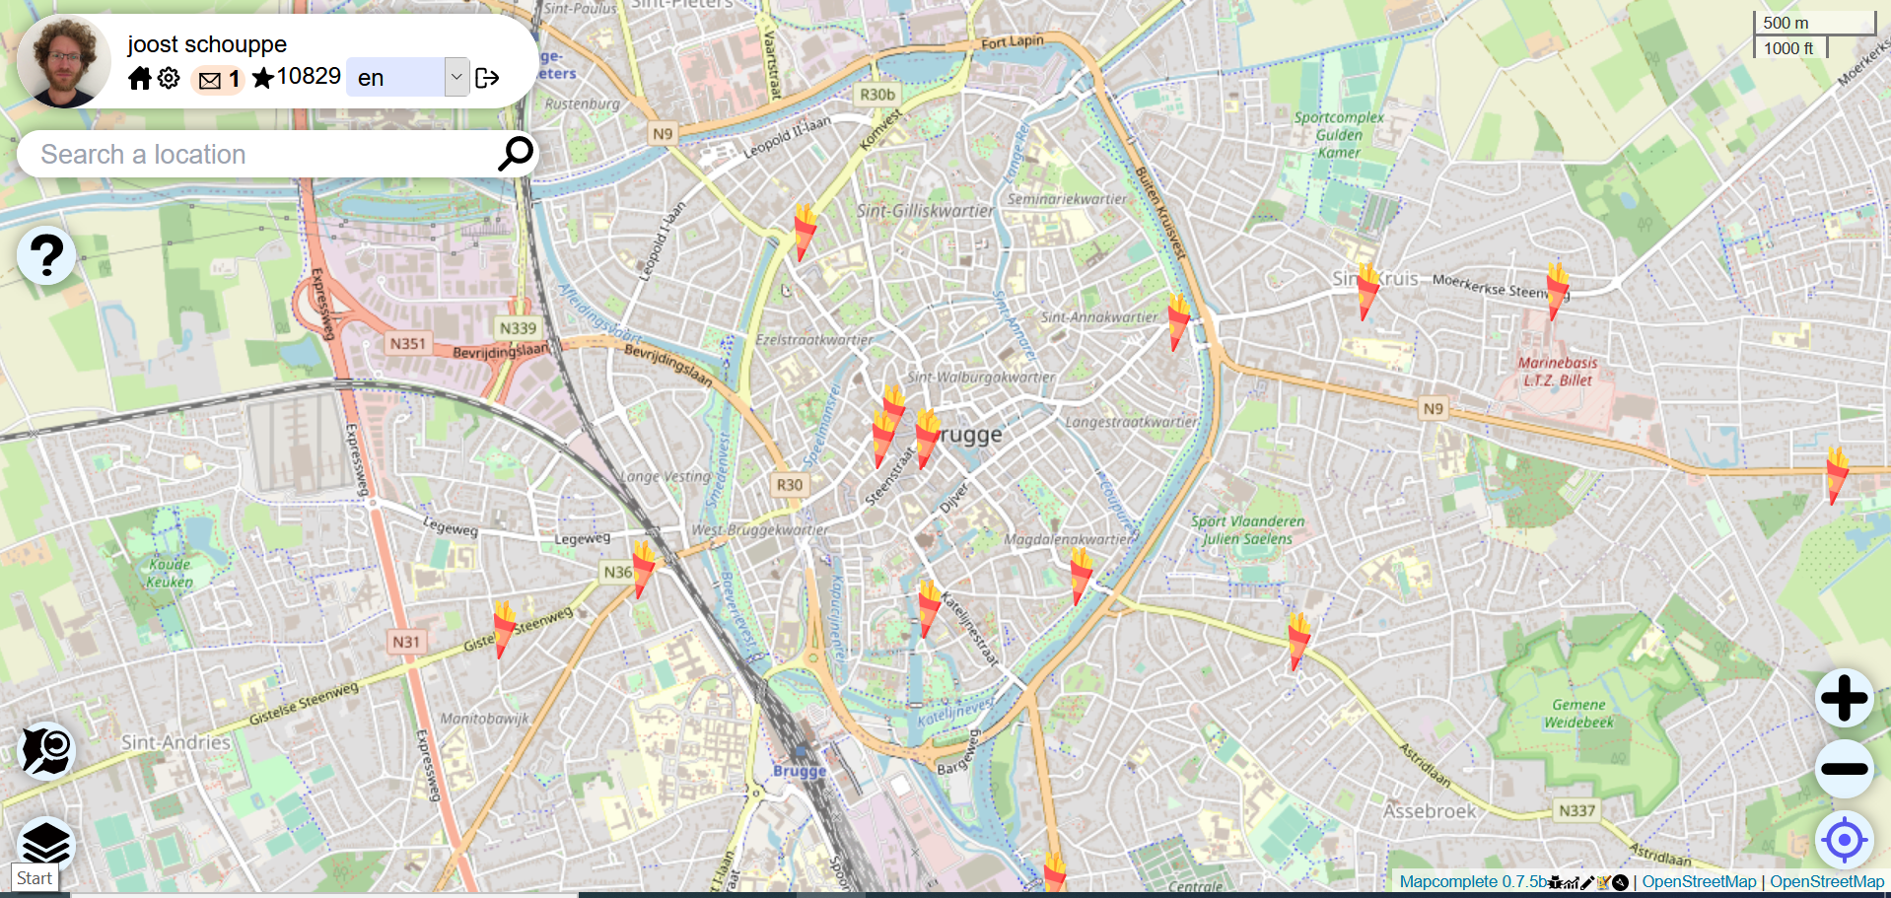
Notes:
People usually just see our background map
But fail to see the hidden depth of the data
For example, we can find all the fritures in Belgium

Slide 7
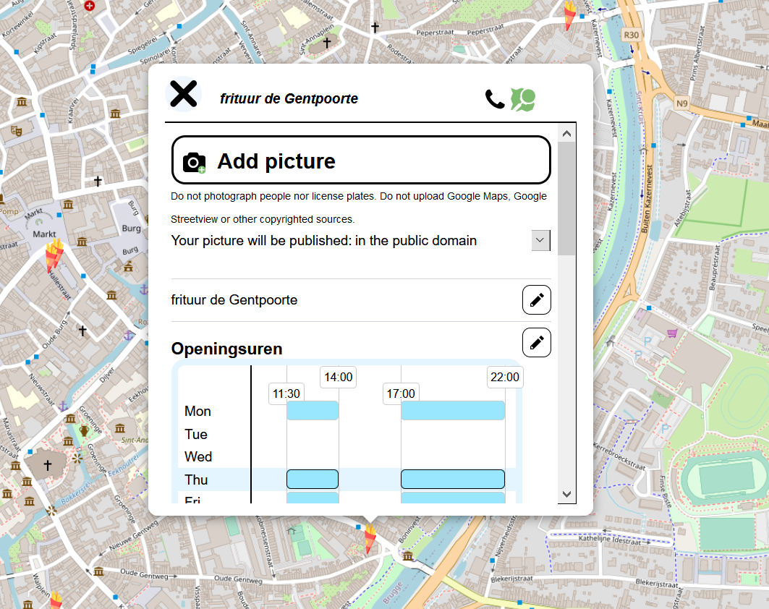
Notes:
But even add their phone number, their opening hours or add a picture!

Slide 8
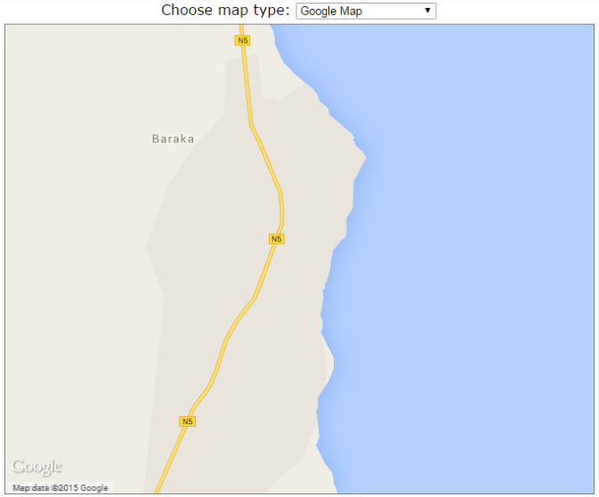
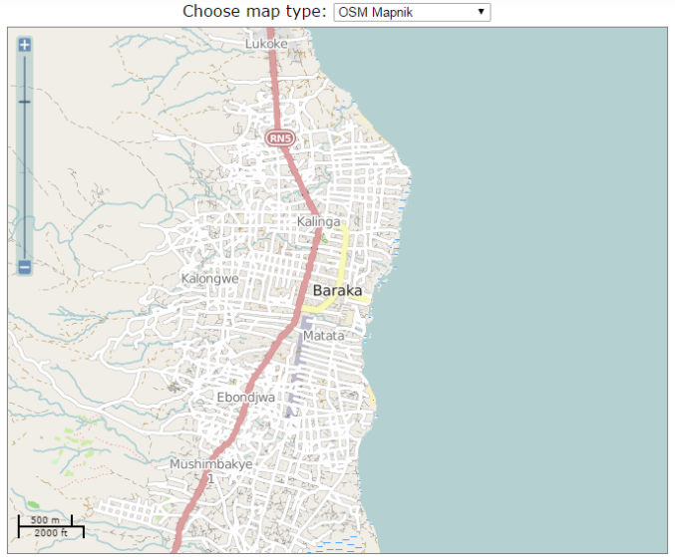
Humanitarian mapping
Often the only data – usually the only data you can actually use
Notes:
De weg vinden
Inventariseren beschadigde gebouwen
Lokaliseren van ebola-patiënten
Schattingen benodigde medicatie
De weg wijzen naar veilige plaatsen
Infrastructuur plannen
Dingen waar we op voorhand nooit aan gedacht hadden

Slide 9
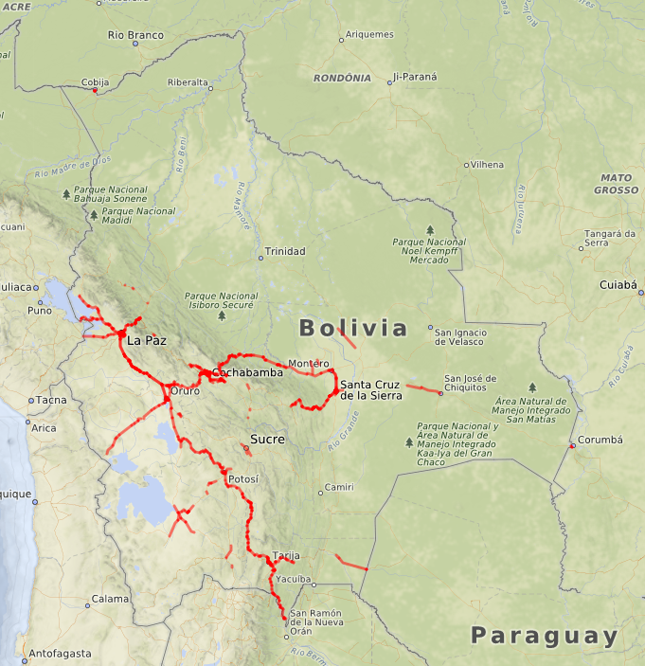
Notes:
With the help of twitter, the map of the Bolivian asphalted roads went from this …

Slide 10
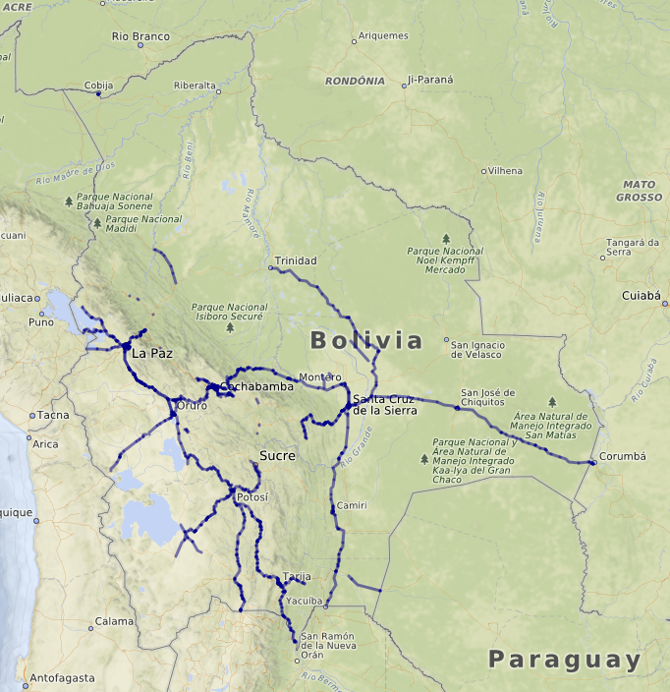
Notes:
to this in just three days. There simply is no other global dataset containing this much road quality data. And it is still easy to make it much much better.

Slide 11
How could this ever work?
Just you, mapping what you know
Notes:
But all this is only possible if -you- complete the data and keep it up to date. There is no "someone should do this or that" or "why don't they do this or that". There is only you, doing things, and leading by example.
And that works best if you start mapping what you know.
So what can I do?

Slide 12

A handcrafted evolving map
Notes:
OpenStreetMap is a handcrafted, evolving map
We started small and mostly with mayor features. But as the map evolves, more and more small details get added.

Slide 13
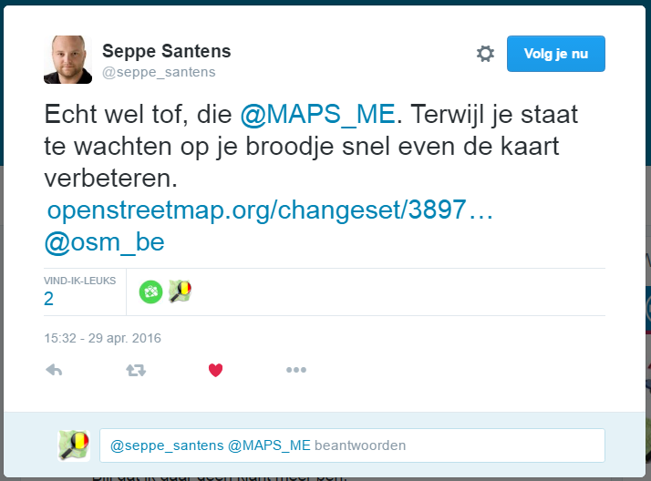
Notes:
A new mapper might start adding the opening hours to the places they use.

Slide 14
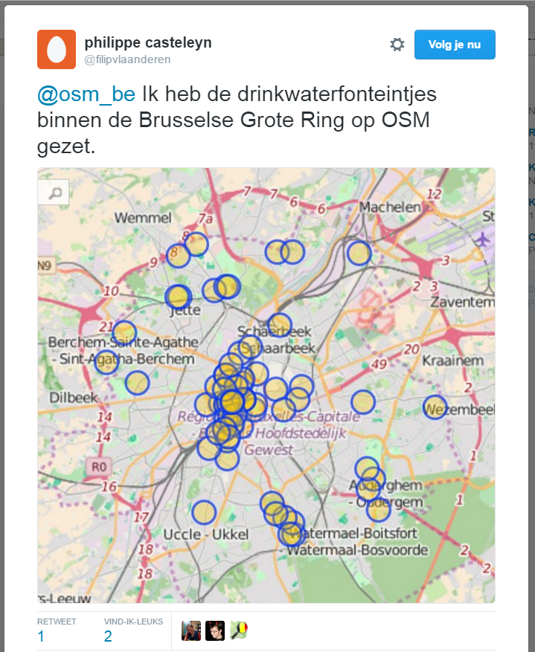
Notes:
Or get a bit more ambitious and map ALL the water fountains in Brussels.

Slide 15
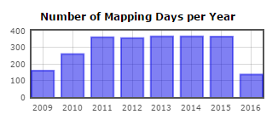
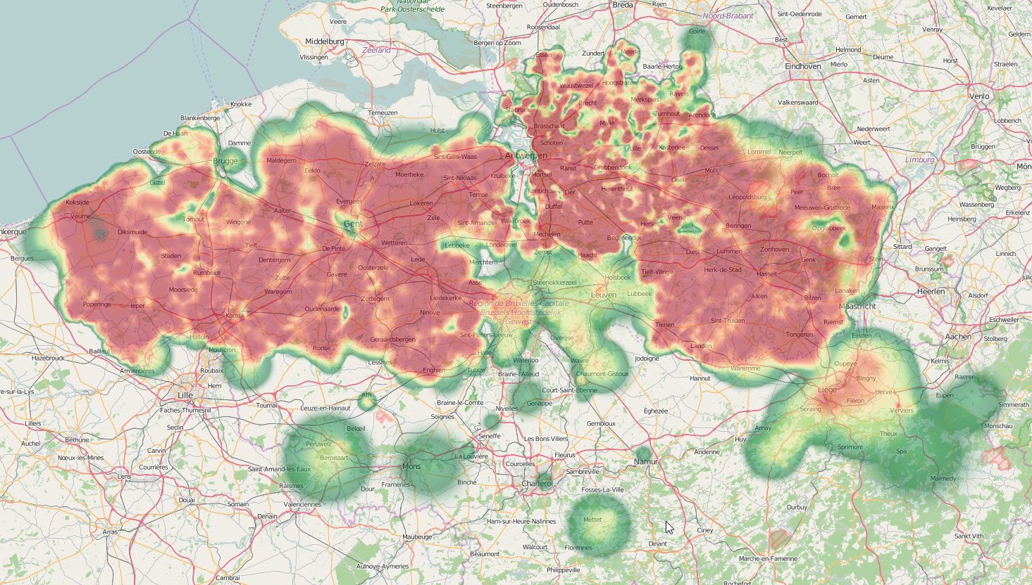
Notes:
And some of us go a little crazy and map ALL DAY EVERY DAY until every little spot in their region has all landuse mapped

Slide 16
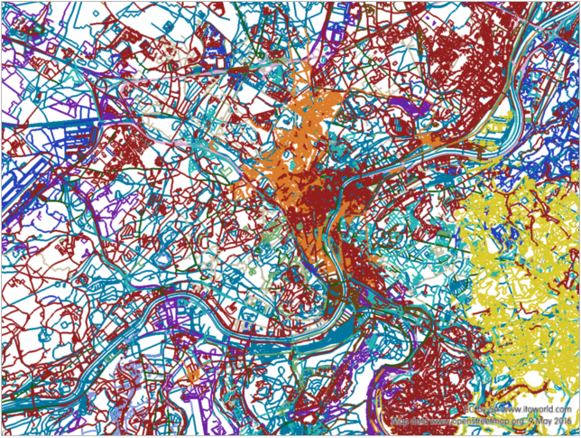
Notes:
Put all this together, and you get a map reflecting the colours of many different people.

Slide 17
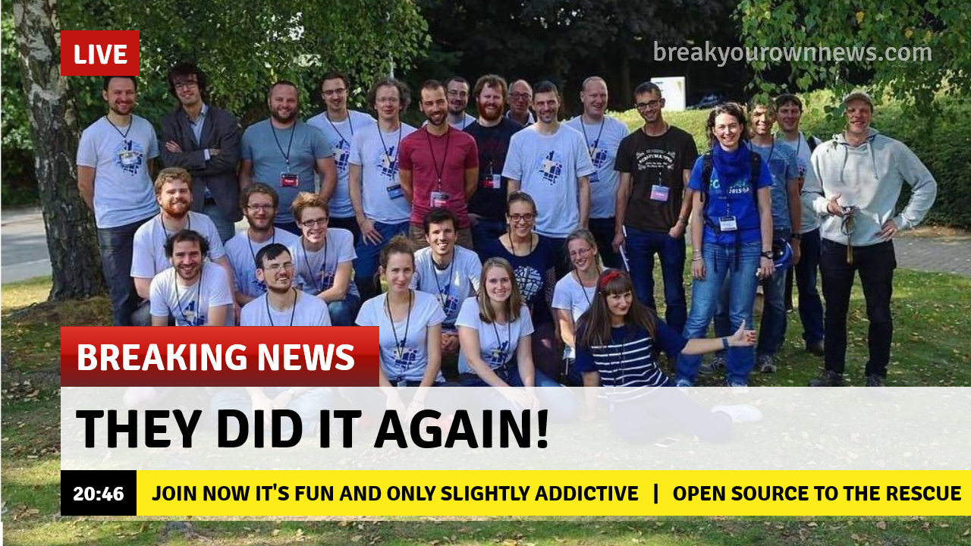
Notes:
We’re a community:
We meet online, mostly on a chat platform
We meet in real life: bar meetups, organized activities, at events

Slide 18
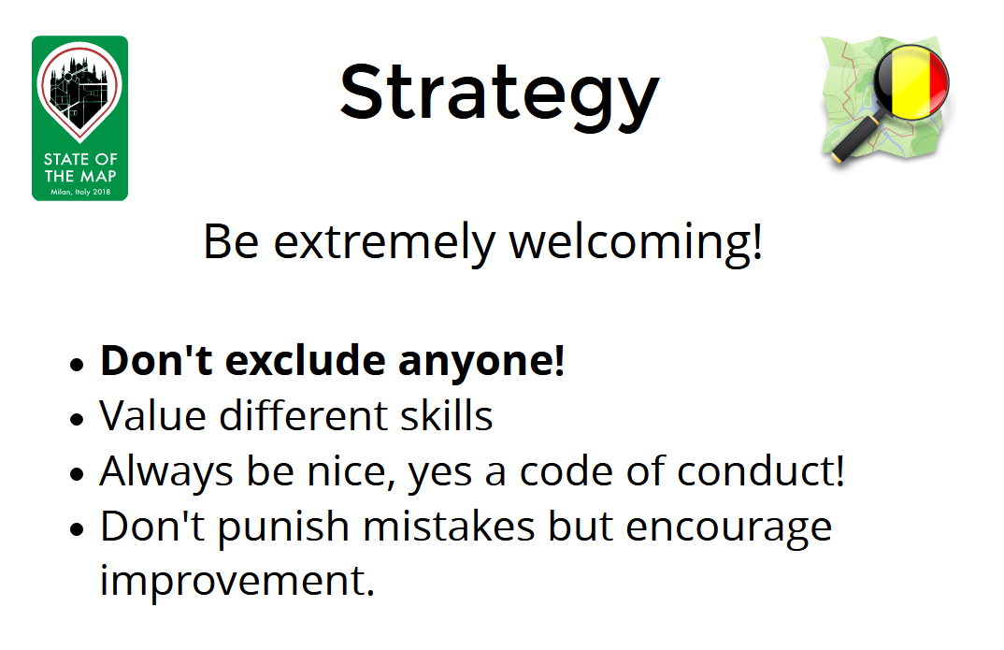

Slide 19
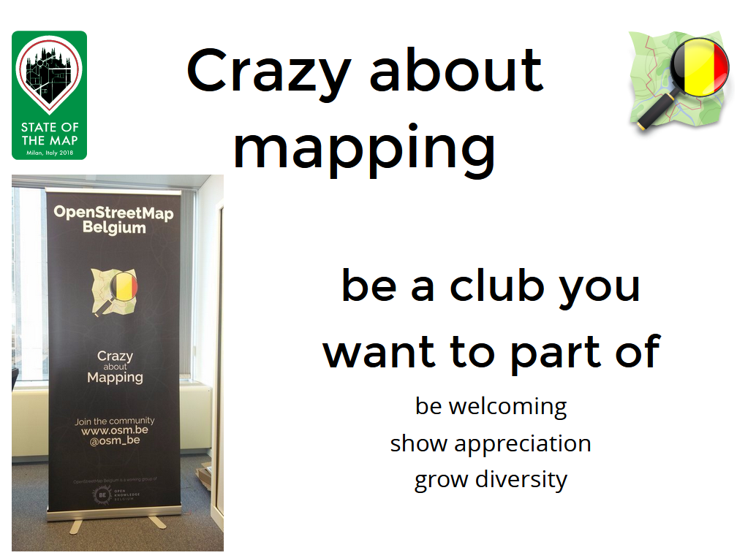

Slide 20
What it is and what it isn’t
Freedom to use data
● As long as you attribute
● As long as you give back improvements
● As long as you don’t kill community servers
Freedom to add data
● As long as it is verifiable on the ground
● As long as it is somewhat permanent
● As long as no copyright is infringed
Notes:
When we say free, we mean freedom! All users have the same powers – we keep each other in check. With a small team to deal with conflicts
When we say free, we mean “build the tools and make them work”. That means tools may be cost-free for you, but run without a budget. Or they may charge a little or a lot of money

Slide 21
Hands on – the web editor

Slide 22
Hands on – setting up Osmand for contributing

Slide 23
Street level imagery

Slide 24
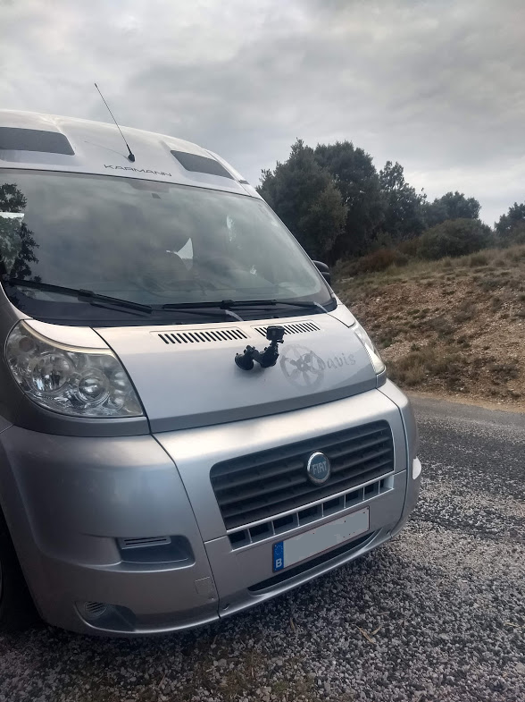
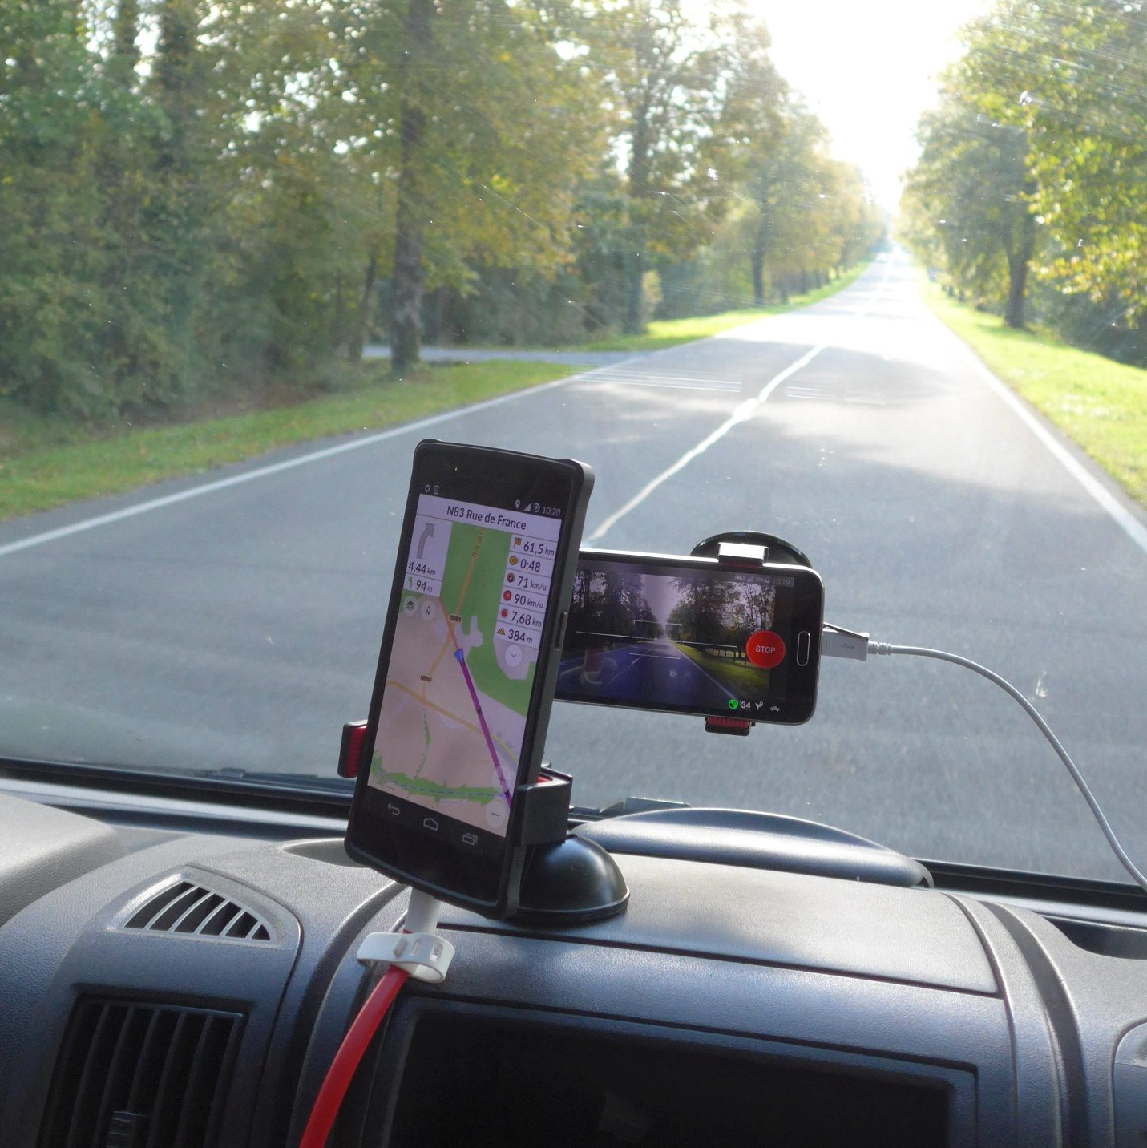
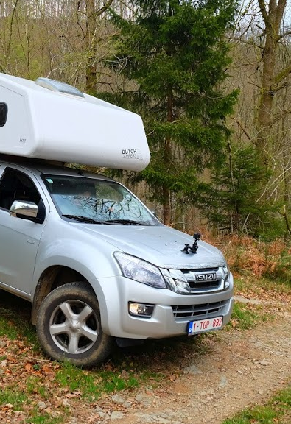
Notes:
https://www.mapillary.com/app/?lat=49.9655482&lng=4.945109&z=17&pKey=149247120556979&focus=photo

Slide 25
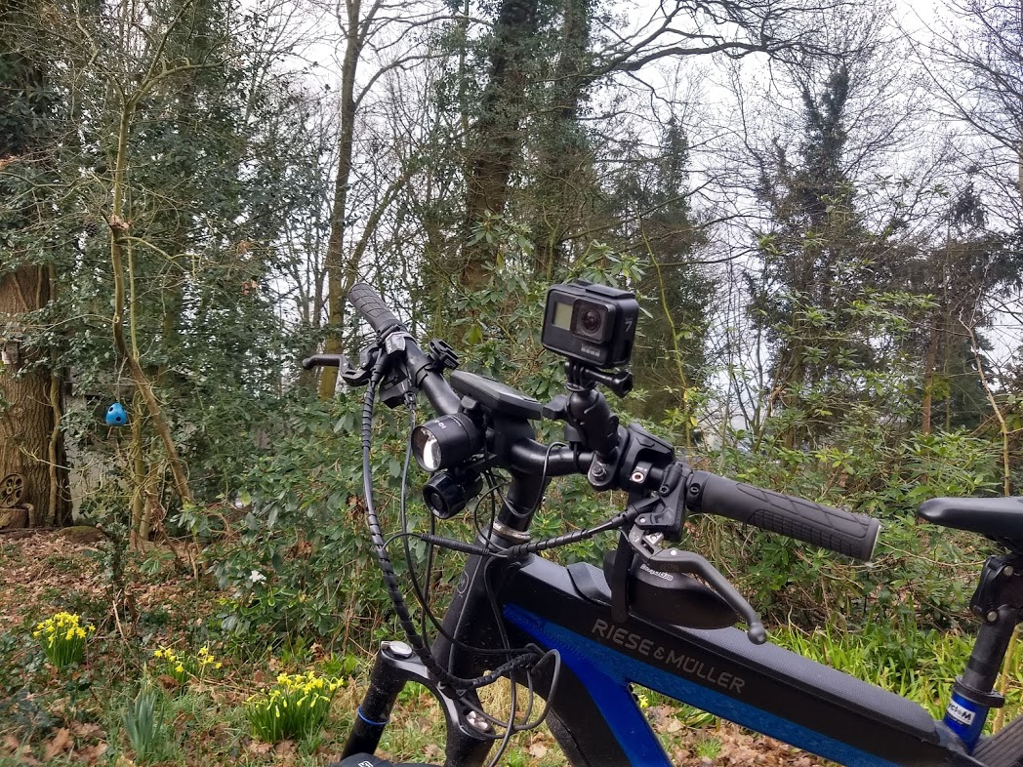
Notes:
https://www.mapillary.com/app/?lat=50.75915114177067&lng=4.262096614973075&z=13.98978307006613&pKey=522114965897270&focus=photo

Slide 26
Hands on – MapComplete

